Slide 1
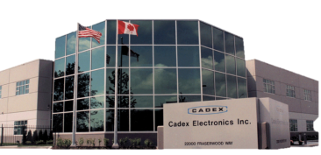

Battery History
--- Training Series ---
By Isidor Buchmann, CEO and Founder
Cadex Electronics Inc.
www.BatteryUniversity.com
Notes:
1
Isidor Buchmann is the founder and CEO of Cadex Electronics Inc., a company that manufactures innovative battery test and diagnostics equipment. Active in wireless communications, Isidor has studied the behavior of rechargeable batteries in practical and everyday use. To share battery knowledge, he wrote many articles, delivered numerous technical papers, published several books including the best selling “Batteries in a Portable World,” and created www.BatteryUniversity.com.

Slide 2
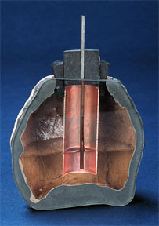
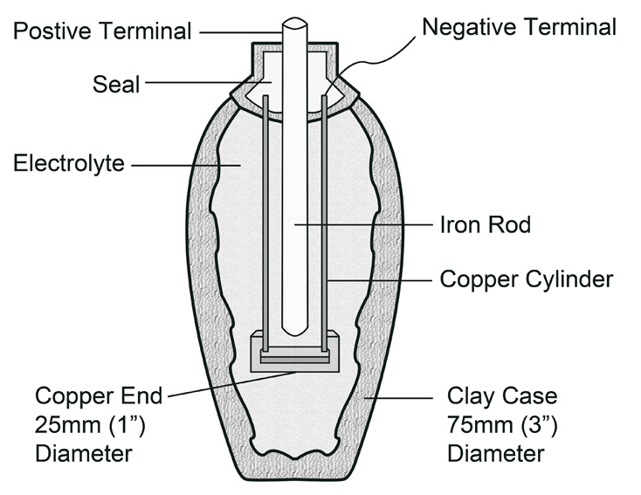
When was the battery invented?
Parthian Battery. A prehistoric battery in a clay jar holds an iron rod surrounded by a copper cylinder (ca. 250BC).

Slide 3
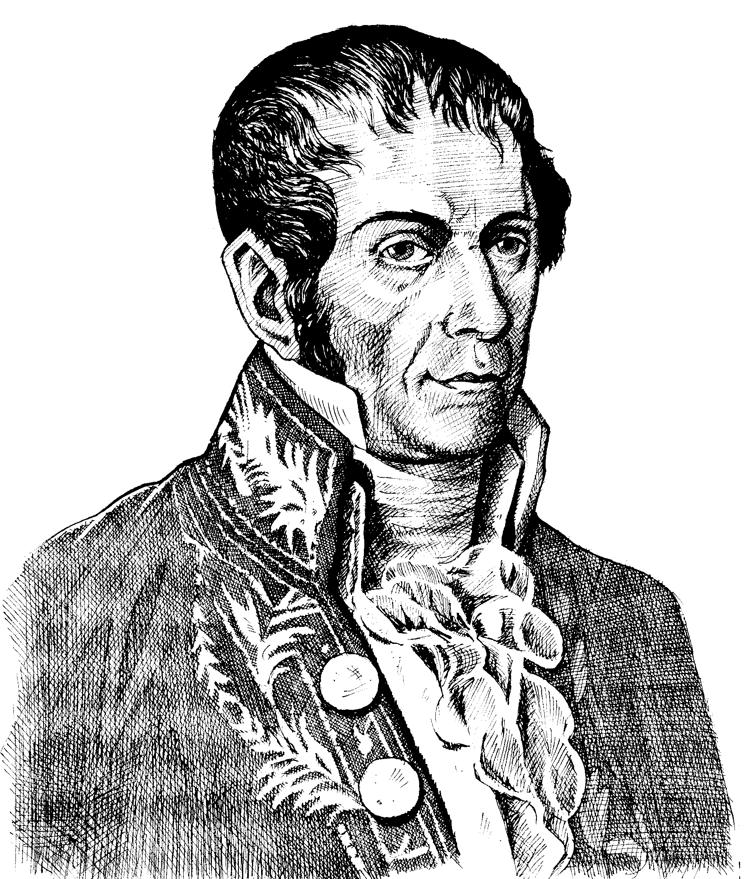
Early batteries
Alessandro Volta discovered that dissimilar metals separated by a moist paper soaked in salt water have different voltage potential.
Zinc = 1.6 / -0.76 V
Lead = 1.9 / -0.13 V
Tin = 1.8 / -1.07 V
Iron = 1.8 / -0.04 V
Copper = 1.9 / 0.159 V
Silver = 1.9 / 1.98 V
Gold = 2.4 / 1.83 V
Carbon = 2.5 / 0.13 V
1st number is the affinity to attract electrons;
2nd is standard potential from first oxidation state

Slide 4
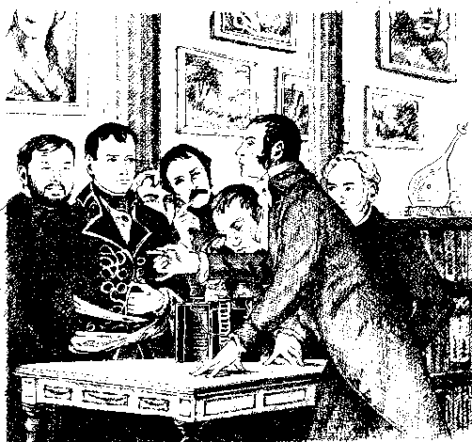
Experimentations at the Institute of France
In November 1800, Napoleon Bonaparte helped Volta with the experiments, drawing sparks from a battery, melting a steel wire, discharging an electric pistol and decomposing water into its elements.

Slide 5
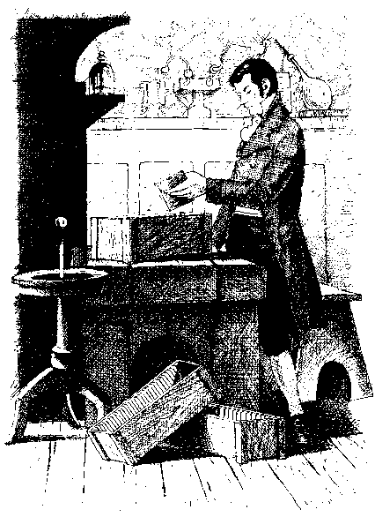
Mass production in 1802
William Cruickshank built the first battery by arranging sheets of copper and zinc
in a long wooden box and soldering them together.
Gaston Planté invented the 1st lead acid battery in 1859.

Slide 6
Battery Developments: 1600 to 1900
Year | Inventor | Achievement
1600 | William Gilbert (UK) | Establishment of electrochemistry study
1791 | Luigi Galvani (Italy) | Discovery of “animal electricity”
1800 1802 1820 1833 1836 1839 1859 1868 1899 | Alessandro Volta (Italy) William Cruickshank (UK) André-Marie Ampère (France) Michael Faraday (UK) John F. Daniell (UK) William Robert Grove (UK) Gaston Planté (France) Georges Leclanché (France) Waldmar Jungner (Sweden) | Invention of the voltaic cell (zinc, copper disks) First electric battery capable of mass production Electricity through magnetism Announcement of Faraday’s law Invention of the Daniell cell Invention of the fuel cell (H₂/O₂) Invention of the lead acid battery Invention of the Leclanché cell (carbon-zinc) Invention of the nickel-cadmium battery

Slide 7
Battery Developments: 1900 to Present
Year | Inventor | Achievement
1901 1932 1947 1949 1970s 1990 1991 1994 1996 1996 | Thomas A. Edison (USA) Shlecht & Ackermann (D) Georg Neumann (Germany) Lew Urry, Eveready Battery Group effort Group effort Sony (Japan) Bellcore (USA) Moli Energy (Canada) University of Texas (USA) | Invention of the nickel-iron battery Invention of the sintered pole plate Successfully sealing the nickel-cadmium battery Invention of the alkaline-manganese battery Development of valve-regulated lead acid battery Commercialization of nickel-metal-hydride battery Commercialization of lithium-ion battery Commercialization of lithium-ion polymer Introduction of Li-ion with manganese cathode Identification of Li-phosphate (LiFePO₄)
2002 | University of Montreal, Quebec Hydro, MIT, others | Improvement of Li-phosphate, nanotechnology, commercialization

Slide 8
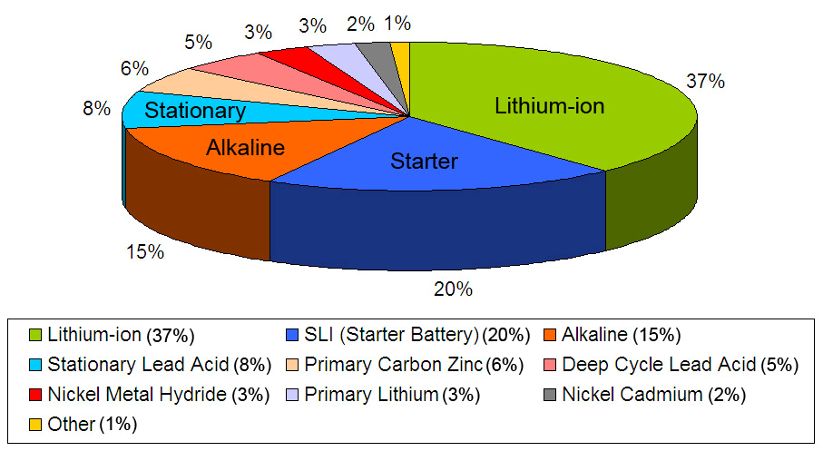
Overview of Battery Types
Courtesy of Frost & Sullivan (2009)

Slide 9
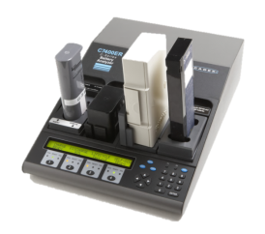
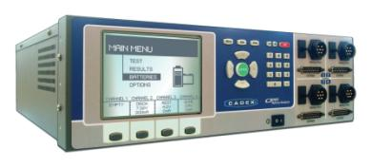
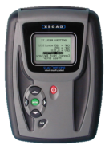
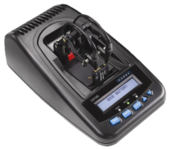
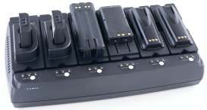
Take home . . .
Cadex Products
Cadex C8000
36V, 10A/station, 400W
Cadex C7400ER
36V, 6A/station, 170W
Spectro CA-12
measures capacity
of lead acid in 15s.
UCC Chargers
Boosts, calibrates, hot/cold charging
Cadex C5100
Tests Li-ion in 30s.
Notes:
9

